Slide 1
GraRep: Learning Graph Representations with Global Structural Information
Authors: Shaosheng Cao, Wei Lu, and Qiongkai Xu
Presented By: Ali Nauman (18L-1863) Samama Butt (18L-1882) Hassan Malik (18L-1894)

Slide 2
Table of Contents
Abstract
General Graph Representation Learning Models - Baseline Algorithms
Related Work
Loss Function
Optimization method using Matrix Factorization
GraRep Algorithm
Mathematical Explanation in relevance to previous work
Evaluation Data
Baseline Algorithms and GraRep Performance
Parameter Sensitivity
Conclusion

Slide 3
Abstract
GraRep – novel model for learning vertex representations of weighted graphs
Learns low-dimensional vectors to represent vertices appearing in a graph
Integrates global structural information of the graph into the learning process
Comparisons to the DeepWalk model as well as the skip-gram model
We conduct experiments on a language network, citation network and show that our learned global representations can be effectively used as features in tasks such as clustering, classification and visualization
Results obtained would show that GraRep significantly outperforms other methods in such tasks

Slide 4
Introduction
Information is often organized using graphs
Examples, social network research, classification of users which can lead to many useful applications such as user research, targeted advertising and recommendations
Learn useful information from the graphs such as graph representations of a graph
Each vertex can be represented with a low-dimensional vector including semantic, relational and structural information conveyed by the graph can be accurately captured.

Slide 5
Baseline Algorithms
DeepWalk
Skip-gram Model
LINE

Slide 6
DeepWalk
Transforms a graph structure into a sample of collection of linear sequences
Uniform Sampling
Issue with weighted graph – discussed later

Slide 7
Skip-gram Model
Learning word representations from a linear sequence
Also used to learn the representations of vertices from such samples
Effective
We shall first present an explicit loss function of the skip-gram model
We can use the skip-gram model to capture the k-step (k = 1, 2, 3, ……K ) relationship between each vertex and its k-step neighbors in the graph with different values of k.
Limitation of the skip-gram model is it projects all such k-step relational information into a common subspace
We shall overcome this in our proposed model by preserving different k-step in distinct subspaces

Slide 8
LINE
A loss function to capture both 1-step and 2-step local relational information.
Model can not be easily extended to capture k-step (with k > 2) relational information for learning their graph representation
One important strategy that we can use to enhance the effectiveness of this model is to consider higher-order neighbors for vertices with small degrees.
This strategy implicitly captures certain kstep information into their model to some extent.
We believe k-step relational information between diﬀerent vertices, with diﬀerent values of k, reveals the useful global structural information associated with the graph, and it is essential to explicitly take full advantage of this when learning a good graph representation

Slide 9
GraRep
It captures the different k-step relational information with different values of k and represents it into distinct sub-spaces.
This model defines different loss functions for capturing the different k-step local relational information
Optimize with matrix factorization technique
Construct the global representations for each vertex by combining different representations learned from different models
Global representations -> features for further processing

Slide 10
Related Work
We shall be talking two things in this which will actually form the basis of our whole work,
Linear Sequence Representation Methods
Graph Representation Approaches

Slide 11
Linear Sequence Representation Methods
Two mainstream methods for learning word representations
Neural embedding methods
Employ a fixed slide window capturing context words of current word
This method may yield good performance on some tasks, they can poorly capture useful information
It uses separate local context windows instead of global co-occurrence counts
Matrix factorization based approaches
This method utilizes global statistics
Previous work include Latent Semantic Analysis (LSA), which decomposes term document matrix and yields latent semantic representations.
Lund et al. put forward Hyperspace Analogue to Language (HAL), factorizing a word-word co-occurrence counts matrix to generate word representations.
We shall be using Skip-Gram model with Negative Sampling (SGNS) which can be regarded as a model that implicitly uses such a matrix

Slide 12
Graph Representation Approaches
We have several approaches to learning low dimensional graph representations
Multidimensional scaling (MDS)
IsoMap
LLE
Laplacian Eigenmaps
We have methods for learning latent representational vectors of the graphs which can then be applied to social network classification
Another method of graph factorization method which use stochastic gradient descent to optimize matrices from large graph
Perozzi et al. presented an approach, which transformed graph structure into several linear vertex sequences by using a truncated random walk algorithm and generated vertex representations by using skip-gram model.
Tang et al. later proposed a large-scale information network embedding, which optimizes a loss function where both 1-step and 2-step relational information can be captured in the learning process.

Slide 13
Graphs and Their Representations
Definition 1: Graph
Definition 2: Graph Representations with Global Structural Information
Loss Function
Optimization with Matrix Factorization

Slide 14

Definition 1: Graph
G = (V,E)
V is the set of vertices with each V indicating one object. E is the set of edges with each E indicating the relationship between two vertices
A path is a sequence of edges which connect a sequence of vertices
Adjacency matrix S for a graph
For an unweighted graph, we have Si,j = 1 if and only if there exists an edge from vi to vj , and Si,j = 0 otherwise.
For a weighted graph, Si,j is a real number called the weight of the edge ei,j , which indicates the significance of edge.
Only non-negative weights are considered
We will use w and c to denote vertices
Let’s say diagonal matrix D is known as the degree matrix for a graph with adjacency matrix S:

Slide 15

Definition 1: Graph
To capture the transitions from one vertex to another, and assume in the adjacency matrix Si,j is proportional to the transition probability from vi to vj , we can define the following (1-step) probability transition matrix,
Ai,j is the probability of a transition from vi to vertex vj within one step.
‘A’ matrix can be regarded as a re-scaled S matrix whose rows are normalized.

Slide 16
Graph Representations with Global Structural Information
Aim is to learn a global representation matrix for a complete graph,
The i-th row Wi is a d-dimensional vector representing the vertex vi in the graph G where the global structural information of the graph can be captured in such vectors.

Slide 17
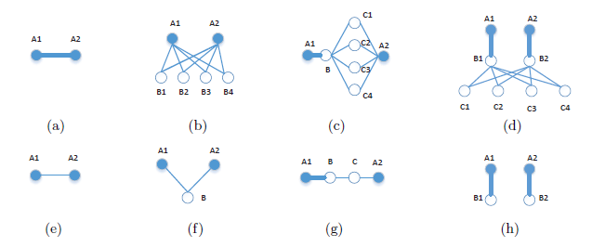
Global Structural Information
It serves two functions in particular,
capture of long distance relationship between two different vertices
consideration of distinct connections in terms of different transitional steps

Slide 18
Global Structural Information
Here, (a) and (e) show the importance of capturing the simple 1-step information between the two vertices which are directly connected to each other, where one has a stronger relation and the other has a weaker relation.
In (b) and (f), 2-step information is shown, where in (b) both vertices share many common neighbors, and in (f) only one neighbor is shared between them.
Clearly, 2-step information is important in capturing how strong the connection between the two vertices is - the more common neighbors they share, the stronger the relation between them
In (c) and (g), the importance of 3-step information is illustrated.
Specifically, in (g), despite the strong relation between A1 and B, the relation between A1 and A2 can be weakened due to the two weaker edges connecting B and C, as well as C and A2.
In contrast, in (c), the relation between A1 and A2 remains strong because of the large number of common neighbors between B and A2 which strengthened their relation
Similarly, the 4-step information can also be crucial in revealing the global structural properties of the graph, as illustrated in (d) and (h).
Here, in (d), the relation between A1 and A2 is clearly strong, while in (h) the two vertices are unrelated since there does not exist a path from one vertex to the other.

Slide 19
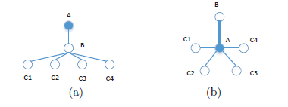
Global Structural Information
It is essential to treat different k-step information differently when learning graph representations.
We can see that A receives two types of information when learning its representation,
1-step information from B
2-step information from all C vertices
If we do not distinguish these two different types of information, we can construct an alternative graph as shown in (b)

Slide 20
In this paper, the authors propose a novel framework for learning accurate graph representations, integrating various k-step information which together captures the global structural information associated with the graph.

Slide 21
Loss Function
Loss function is used for learning the graph representations with global structural information
In order for us to learn global representations to capture their relations,
we need to understand how strongly these two vertices are connected to each other

Slide 22
Loss Function
We need to work on a few questions
Does there exist a path from w to c?
If so, if we randomly sample a path starting with w, how likely is it for us to reach c within a fixed number of steps

Slide 23


Loss Function
probability for a transition from w to c in exactly k steps.
To compute the k-step transition probabilities we introduce the following k-step probability transition matrix,
This exactly refers to the transition probability from vertex i to vertex j where the transition consists of exactly k step(s). This leads to,

Slide 24


Loss Function
Our objective aims to maximize:
the probability that these pairs come from the graph,
the probability that all other pairs do not come from the graph
Motivated by the skip-gram model, we employ noise contrastive estimation (NCE), to define our objective function.
We first introduce our k-step loss function defined over the complete graph as follows:

Slide 25



Loss Function
We define e = w.c and setting the differential to 0, yields to the following,
This concludes that we essentially need to factorize the matrix Y into two matrices W and C, where each row of W and each row of C consists of a vector representation for the vertex w and c respectively, and the entries of Y are:

Slide 26


Optimizing with Matrix Factorization
To reduce noise, we replace all negative entries in Y with 0.
We focus on the popular Singular Value Decomposition (SVD) method due to its simplicity
It is regarded as one of the important methods that can be used for dimensionality reduction
SVD factorizes it as,

Slide 27


Optimizing with Matrix Factorization
We can factorize our matrix X as,
where,
Why we use SVD and not any other dimensionality reduction method?

Slide 28
Algorithm
Graph representations are extracted for other applications as features, such as classification and clustering.
Way to encode k-step representation in practice is to concatenate the k-step representation as a global feature for each vertex

Slide 29
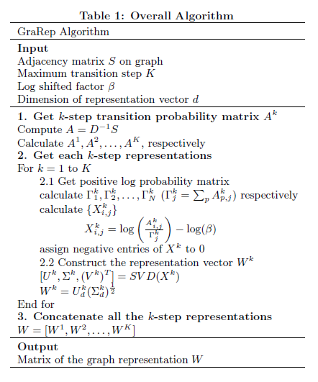

Slide 30
Algorithm – Step 1
Get k-step transition probability matrix ‘A’ for each k = (1, 2, ….k).
Calculate the k-step transition probability matrix through the product of inverse of degree matrix D and adjacent matrix S.
For a weighted graph, S is a real matrix, while for an unweighted graph, S is a binary matrix.

Slide 31
Algorithm – Step 2
Get each k-step representation
We get k-step log probability matrix, X,
then subtract each entry by log (beta), and replace the negative entries by zeros.
we construct the representational vectors as rows of W
introduce a solution to factorize the positive log probability matrix using SVD
Finally, we get all k-step representations for each vertex on the graph

Slide 32
Algorithm – Step 3
Concatenate all k-step representations
We concatenate all k-step representations to form a global representation, which can be used in other tasks as features
Now these extracted features will be used for classification, clustering and many other Machine Learning models

Slide 33
Mathematical Explanation in relevance to previous work
Now we shall give a mathematical explanation to elucidate or clarify the rationality of the proposed work and show its connection to the previous work.
We know that GraRep aims to learn representations for graphs where we optimize the loss function based on matrix factorization
SGNS – Skip-gram Negative Sampling has shown to be successful in handling linear structures such as natural language sentences
We will shed light on how SGNS is viewed as a special case of the GraRep model

Slide 34
Explicit Loss of Skip-gram Model
SGNS aims at representing words in linear sequences, thus we need to transform the graph into linear structures
Deepwalk is an effective way with uniform sampling – truncated random walk
It samples uniformly a random vertex from the graph
Walks randomly to one of its neighbors and repeats the process
The length of sequence reaches a certain preset value, then stop and start generating a new sequence
Thus, producing a large number of sequences
Issue with weighted graph

Slide 35
Explicit Loss of Skip-gram Model
Deepwalk Issue – weighted graph
Need a probabilistic method based on the edge weight
Not employed by deepwalk
Proposed solution: Enhanced SGNS (E-SGNS)

Slide 36



Enhanced SGNS (E-SGNS)
First we consider total k-step loss L on whole graph,
Here, f, is a linear combination of its arguments defined as follows,
As earlier we assign the partial derivative to ‘0’, and get a factorized matrix for E-SGNS
M – transition probability matrix within K-step(s)
Mi,j – transition probability from vertex i to vertex j

Slide 37
Enhanced SGNS (E-SGNS)
Difference between E-SGNS and GraRep,
It is based on the definition of the function, f
E-SGNS can be considered as a linear combination of k-step loss
Each loss has an equal weight
GraRep model does not make such a strong assumption, but allows their (potentially non-linear) relationship to be learned from data in practice
Thus we can say, different k-step transition probabilities should have different weights, and linear combination of these may not achieve desirable results for heterogeneous network data

Slide 38
Intrinsic Relation Between Sampling and Transition Probabilities
Transition probabilities to measure relationship between vertices
Is this reasonable?

Slide 39
Intrinsic Relation Between Sampling and Transition Probabilities
Among the sequences generated by random walk, we assume vertex w occurs total times:
Expected number of times that we see c1 as its direct neighbor (1-step away from w) is:
This holds for both uniform sampling for unweighted graphs and the proposed probabilistic sampling for the weighted graphs

Slide 40

Intrinsic Relation Between Sampling and Transition Probabilities
Further, we analyze the expected number of times of co-occurrence for w and c of context window size 2,

Slide 41



Intrinsic Relation Between Sampling and Transition Probabilities
Similarly, we can derive the equations for k = (3,4,…..,K)
Add them up and divide both sides by k,

Slide 42

Intrinsic Relation Between Sampling and Transition Probabilities
Thus, we can say M is,
Now, we can also compute the expected number of times we see c as the context vertex,
where we consider the transitions from all possible vertices to c.

Slide 43


Intrinsic Relation Between Sampling and Transition Probabilities
To find the relationship with SGNS model, we consider a special case,
This follows a uniform distribution,
We can arrive at the following equation,
This matrix becomes exactly the same as that in SGNS

Slide 44
Intrinsic Relation Between Sampling and Transition Probabilities
This shows SGNS is essentially a special version of our GraRep model that deals with linear sequences which can be sampled from graphs.
Several advantages over the slow and expensive sampling process
Typically involves several parameters to tune, such as maximum length of linear sequence, sampling frequency for each vertex, and so on

Slide 45
Evaluation Data
We shall see the effectiveness of GraRep model through experiments on several real-world datasets for several different tasks and make comparisons with the baseline algorithms
20-Newsgroup
Blogcatalog
DBLP Network
Three different types of tasks, including clustering, classification, and visualization
Conducted experiments on both weighted and unweighted graphs, and both sparse and dense graphs
Note: This paper does not employ alternative more efficient matrix factorization methods apart from SVD

Slide 46
20-Newsgroup
Language Network
Fully connected and weighted graph
20,000 newsgroup documents and is partitioned by 20 different groups
Each document is represented by a vector with tf-idf scores of each word
Cosine similarity is used to calculate the similarity between two documents
Based on these similarities, a language network is built
Also, in order to show robustness, 3 graphs are built from 3, 6, and 9 different newsgroup respectively
Demonstrate the results of clustering using graph representation as features.

Slide 47
Blogcatalog
Social network, where each vertex indicates one blogger author, and each edge corresponds to the relationship between authors
39 different types of topic categories are presented by authors as labels
Unweighted graphs
Test the performance of the learned representations on the multi-label classification task
Graph representations generated from GraRep model and each baseline algorithm are considered as features

Slide 48
DBLP Network
Citation network
Extract author citation network from DBLP
Each vertex indicates one author
The number of references from one author to the other is recorded by the weight of edge between these two authors
Selected 6 different popular conferences and assign them into 3 groups
WWW and KDD are grouped as data mining
NIPS and ICML as machine learning
VPR and ICCV as computer vision
Learned representations from all systems using a visualization tool t-SNE

Slide 49
Review – Baseline Algorithms
LINE
DeepWalk
E-SGNS
Spectral Clustering

Slide 50
LINE
Proposed method for learning graph representations on large-scale information networks
It defines a loss function based on 1-step and 2-step relational information between vertices.
One strategy to improve the performance of vertices with small degrees is to make graph denser by expanding their neighbors
Best performance, if concatenating the representation of 1-step and 2-step relational information
Also, tuning the threshold of maximum number of vertices will improve the model further

Slide 51
DeepWalk
It is a method that learns the representation of social networks
Only works for unweighted graph
For each vertex, truncated random walk is used to translate graph structure into linear sequences
Skip-gram model with hierarchical softmax is used as the loss function for DeepWalk

Slide 52
E-SGNS
Efficient model that learns the representation of each word in large corpus
We first utilize uniform sampling for unweighted graph
Probabilistic sampling proportional to weight of edges for weighted graph
This way we generate linear vertex sequences, and then optimize SGNS to optimize
This method can be regarded as a special case of GraRep model, where different representational vector of each k-step information is averaged

Slide 53
Spectral Clustering
Reasonable model, aims at minimizing Normalized Cut (NCut).
normalized cuts approach - measures the similarity between different parts, and measures the total similarity of vertices in the same part
Spectral clustering also factorize a matrix, but it focuses on a different matrix of the graphs (the Laplacian Matrix)
Thus we can say, difference between spectral clustering and E-SGNS lies on their different loss function

Slide 54
Parameter Setting
LINE
mini-batch size of stochastic gradient descent (SGD) as 1
learning rate of starting value as 0.025
number of negative samples as 5
total number of samples as 10 billion
concatenate both 1-step and 2-step relational information to form the representations
employ the reconstruction strategy for vertices with small degrees to achieve the optimal performance
DeepWalk and E-SGNS, we set window size as 10, walk length as 40, walks per vertex as 80

Slide 55
Parameter Setting
LINE yielded better results when the learned graph representations are L2 normalized
L2 Normalized - rescale the representation of each document
Rescaling in this way means that the length of a document (the number of words) does not change the vectorized representation
DeepWalk and E-SGNS can achieve optimal performance without normalization
For GraRep, we found the L2 normalization yielded better results

Slide 56
Parameter Setting
For a fair comparison,
the dimension d of representations is set as 128 for Blogcatalog network DBLP network
64 for 20-NewsGroup network
For GraRep, β = 1/N, and maximum matrix transition step K=6 for Blogcatalog network and DBLP network and K=3 for 20-NewsGroup network

Slide 57
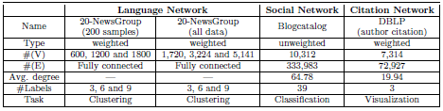
Statistics of real-world graphs

Slide 58
Experimental Results
Now we shall present, empirical justifications that GraRep model can integrate different k-step local relational information into a global graph representation for different types of graphs
It can then be effectively used for different tasks

Slide 59
20-Newsgroup Network
Clustering task by employing the learned representations in a k-means algorithm
To assess the quality of the results, we report the averaged Normalized Mutual Information (NMI) score,
Good measure for determining the quality of clustering
External measure because we need the class labels of the instances to determine the NMI
Since it’s normalized we can measure and compare the NMI between different clustering having different number of clusters
10 different runs for each system

Slide 60
20-Newsgroup Network
Results when dimension d is set to 192 for DeepWalk, E-SGNS and Spectral Clustering
For LINE, we employ the reconstruction strategy proposed by their work by adding neighbors of neighbors as additional neighbors to improve performance
k-max=0, 200, 500, 1000 for experiments,
where k-max is a parameter that is used to control how the higher-order neighbors are added to each vertex in the graph

Slide 61
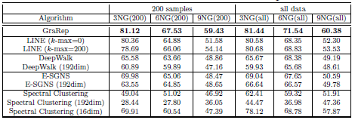
20-Newgroup Network

Slide 62
Blogcatalog Network
Focus on a supervised task on a social network
Evaluate the effectiveness of different graph representations through a multi-label classification task
For each round, we randomly sample 10% to 90% of the vertices and use these samples for training
Report F1 Scores
F1 score is a measure of a test's accuracy
It considers both the precision p and the recall r of the test to compute the score
Set k-max as 0, 200, 500 and 1000, respectively, and we report the best performance with k-max= 500

Slide 63
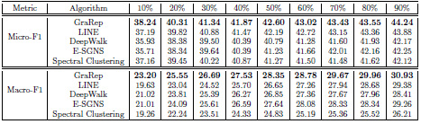
Blogcatalog Network

Slide 64
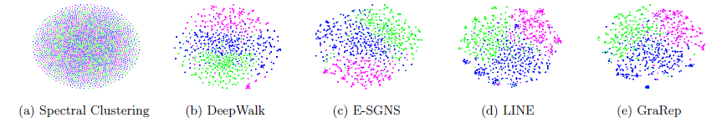
DBLP Network
Focus on visualizing the learned representations by examining a real citation network
Feed the learned graph representations into the standard t-SNE tool
The graphs are visualized on a 2-dimensional space and the Kullback-Leibler divergence is reported
KL captures the errors between the input pairwise similarities
a lower KL divergence score indicates a better performance

Slide 65

DBLP Network
Under the same parameter setting, a lower KL divergence indicates a better graph representation
GraRep yields better representations than all other baseline methods

Slide 66
Parameter Sensitivity
We assess the how the different choices of the maximal k-step size K, as well as the dimension d for our representations can affect our results
Setting K=2 has a significant improvement over the setting K=1, and K=3 further outperforms K=2
This confirms that different k-step can learn complementary local information
When k is large enough, learned k-step relational information becomes weak and shifts towards a steady distribution
The performance of K=7 is no better than K=6
Performance of K=4 is slightly better than K=3, while the results for K=5 is comparable to K=4.

Slide 67
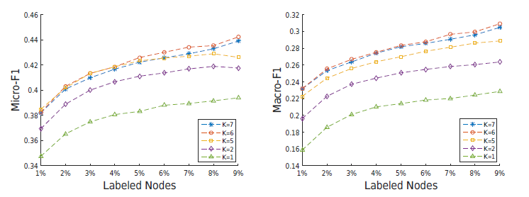
Parameter Sensitivity

Slide 68
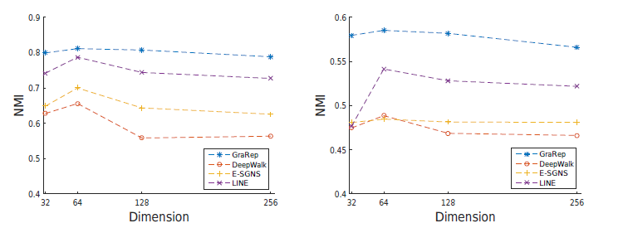
Parameter Sensitivity
NMI scores of each algorithm over different settings of the dimension d on 3NG and 9NG data

Slide 69
Parameter Sensitivity
GraRep consistently outperforms other baseline algorithms which learn representations with the same dimension
All algorithms can obtain the optimal performance with d = 64
As we increase d from 64 to larger values, it appears that the performances of all the algorithms start to drop

Slide 70
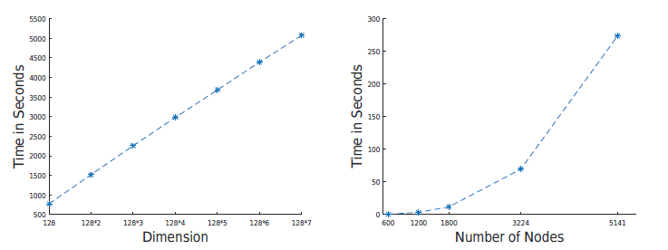
Parameter Sensitivity
Running time over different dimensions as well as over different graph sizes

Slide 71
Parameter Sensitivity
K from 1 to 7 where each complementary feature vector has a dimension of 128
This set of experiments is conducted on the Blogcatalog dataset which contains around 10,000 vertices
Running time increases approximately linearly as the dimension increases
Running time with respect to graph sizes
Large increase in running time is mainly due to high time complexity involved in the computation of the power of a matrix and the SVD procedure

Slide 72
Conclusion
GraRep outperforms other graph representation methods, and is trivially parallelizable
learn latent representations of vertices on graphs, which can capture global structural information associated with the graph
an understanding of the uniform sampling method used in DeepWalk for learning graph representations
Define their loss function over graphs and extend it to support weighted graphs.
analyze the deficiency associated with the skip-gram model with negative sampling
more accurate loss function that allows non-linear combinations of different local relational information to be integrated

Slide 73
Conclusion
This model comes with one limitation the expensive computation of the power of a matrix and SVD involved in the learning process
Proposed Future Work
Investigation of efficient and online methods to approximate matrix algebraic manipulations
Investigation of alternative methods by employing deep architectures for learning low-dimensional representations in place of SVD

